Slide 1
Human-Machine Teaming Hackathon Challenge – Agent Development
Glen Smith | Georgia Institute of Technology
Notes:
Dice adventure
Reinforcement learning model (PPO)
State representation and training interface
Video comparison?
HTN model
State representation

Slide 2
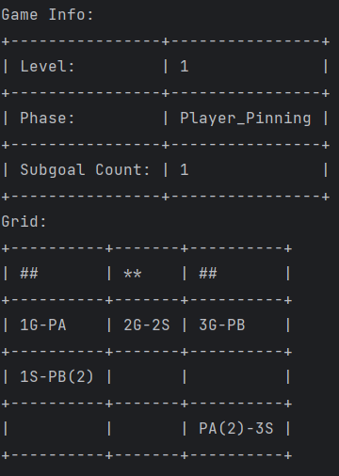
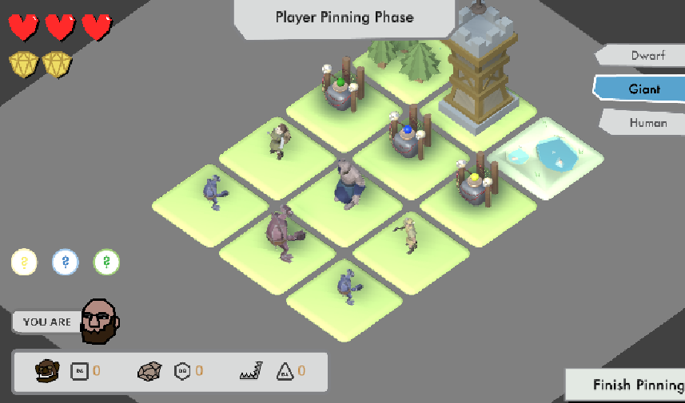
Agent Training Interface
Python version of Dice Adventure to train agents
Simple ‘gymnasium’ environment interface
Can train many kinds of models including offline and online

Slide 3
Agent Submission
We will open the submission portal on 5/1/24
Exact submission format will be communicated in advance
We encourage submission of online and offline agents

Slide 4
Example Models

Slide 5
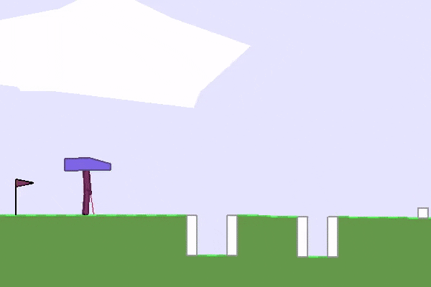
PPO Model (Proximal Policy Optimization) - Offline
State-of-the-art class of reinforcement learning models developed by OpenAI, creator of ChatGPT
Learns complex tasks with less hyperparameter tuning than similar models and achieves comparable performance
Great for high-dimensional environments (such as Dice adventure)
https://medium.com/@ngoodger_7766/proximal-policy-optimisation-in-pytorch-with-recurrent-models-edefb8a72180
https://openai.com/research/openai-baselines-ppo

Slide 6
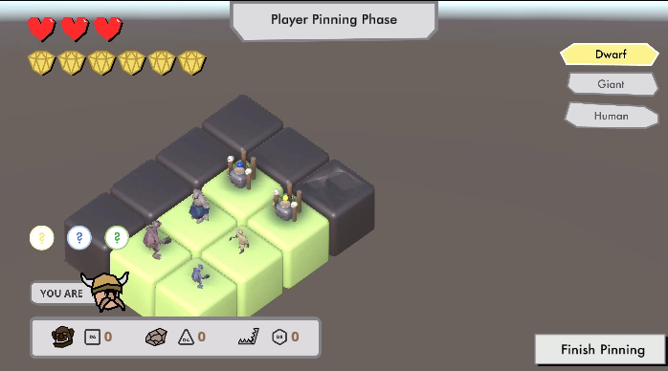
Notes:
Little over 1000 dimensional vector

Slide 7
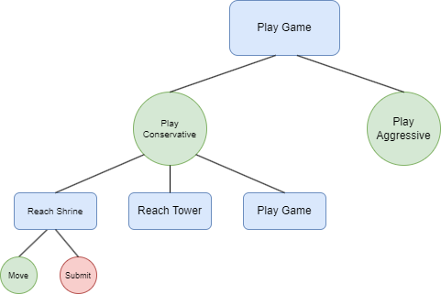
Hierarchical Task Network Model - Online
We’re exploring the use of online models that learn and adapt on the fly
Common, yet powerful model is hierarchical task network (HTN)
HTN and PPO model are our baselines
Notes:
Reference David/Allesandro's presentations -> structured decision making

Slide 8
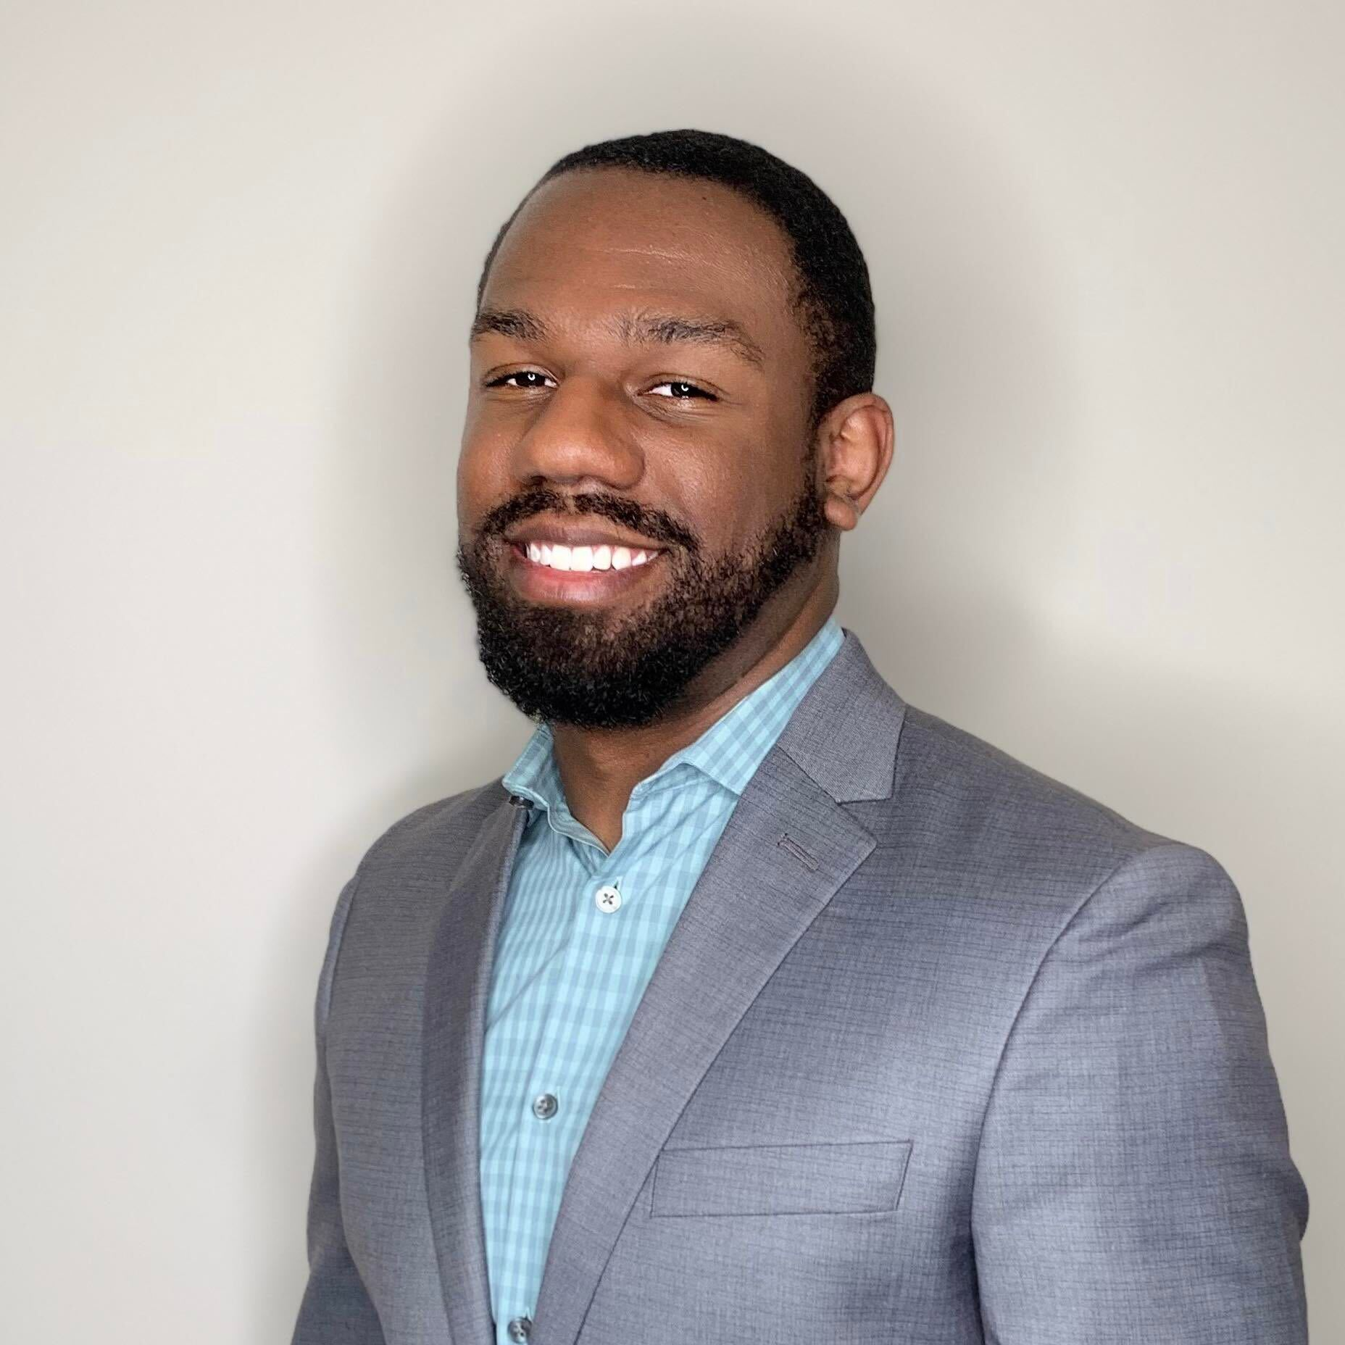
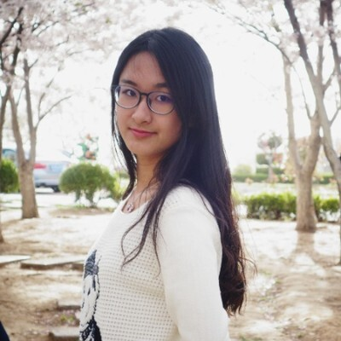
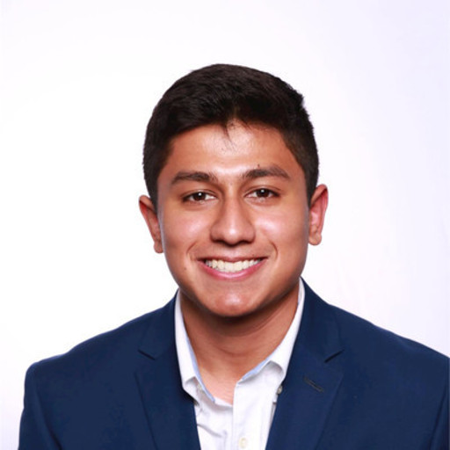

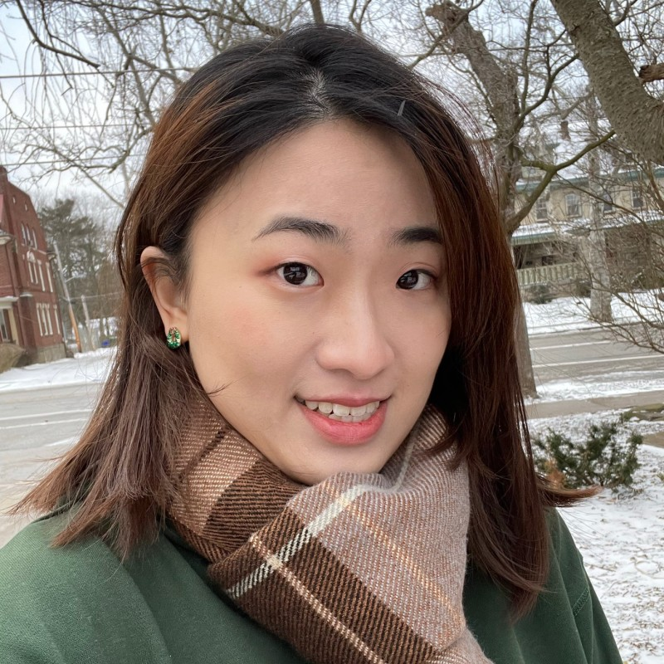
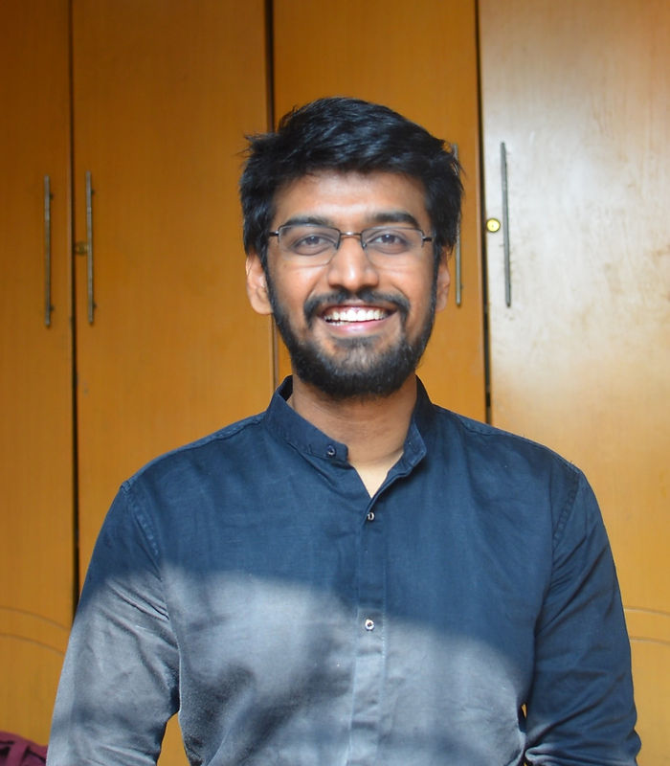
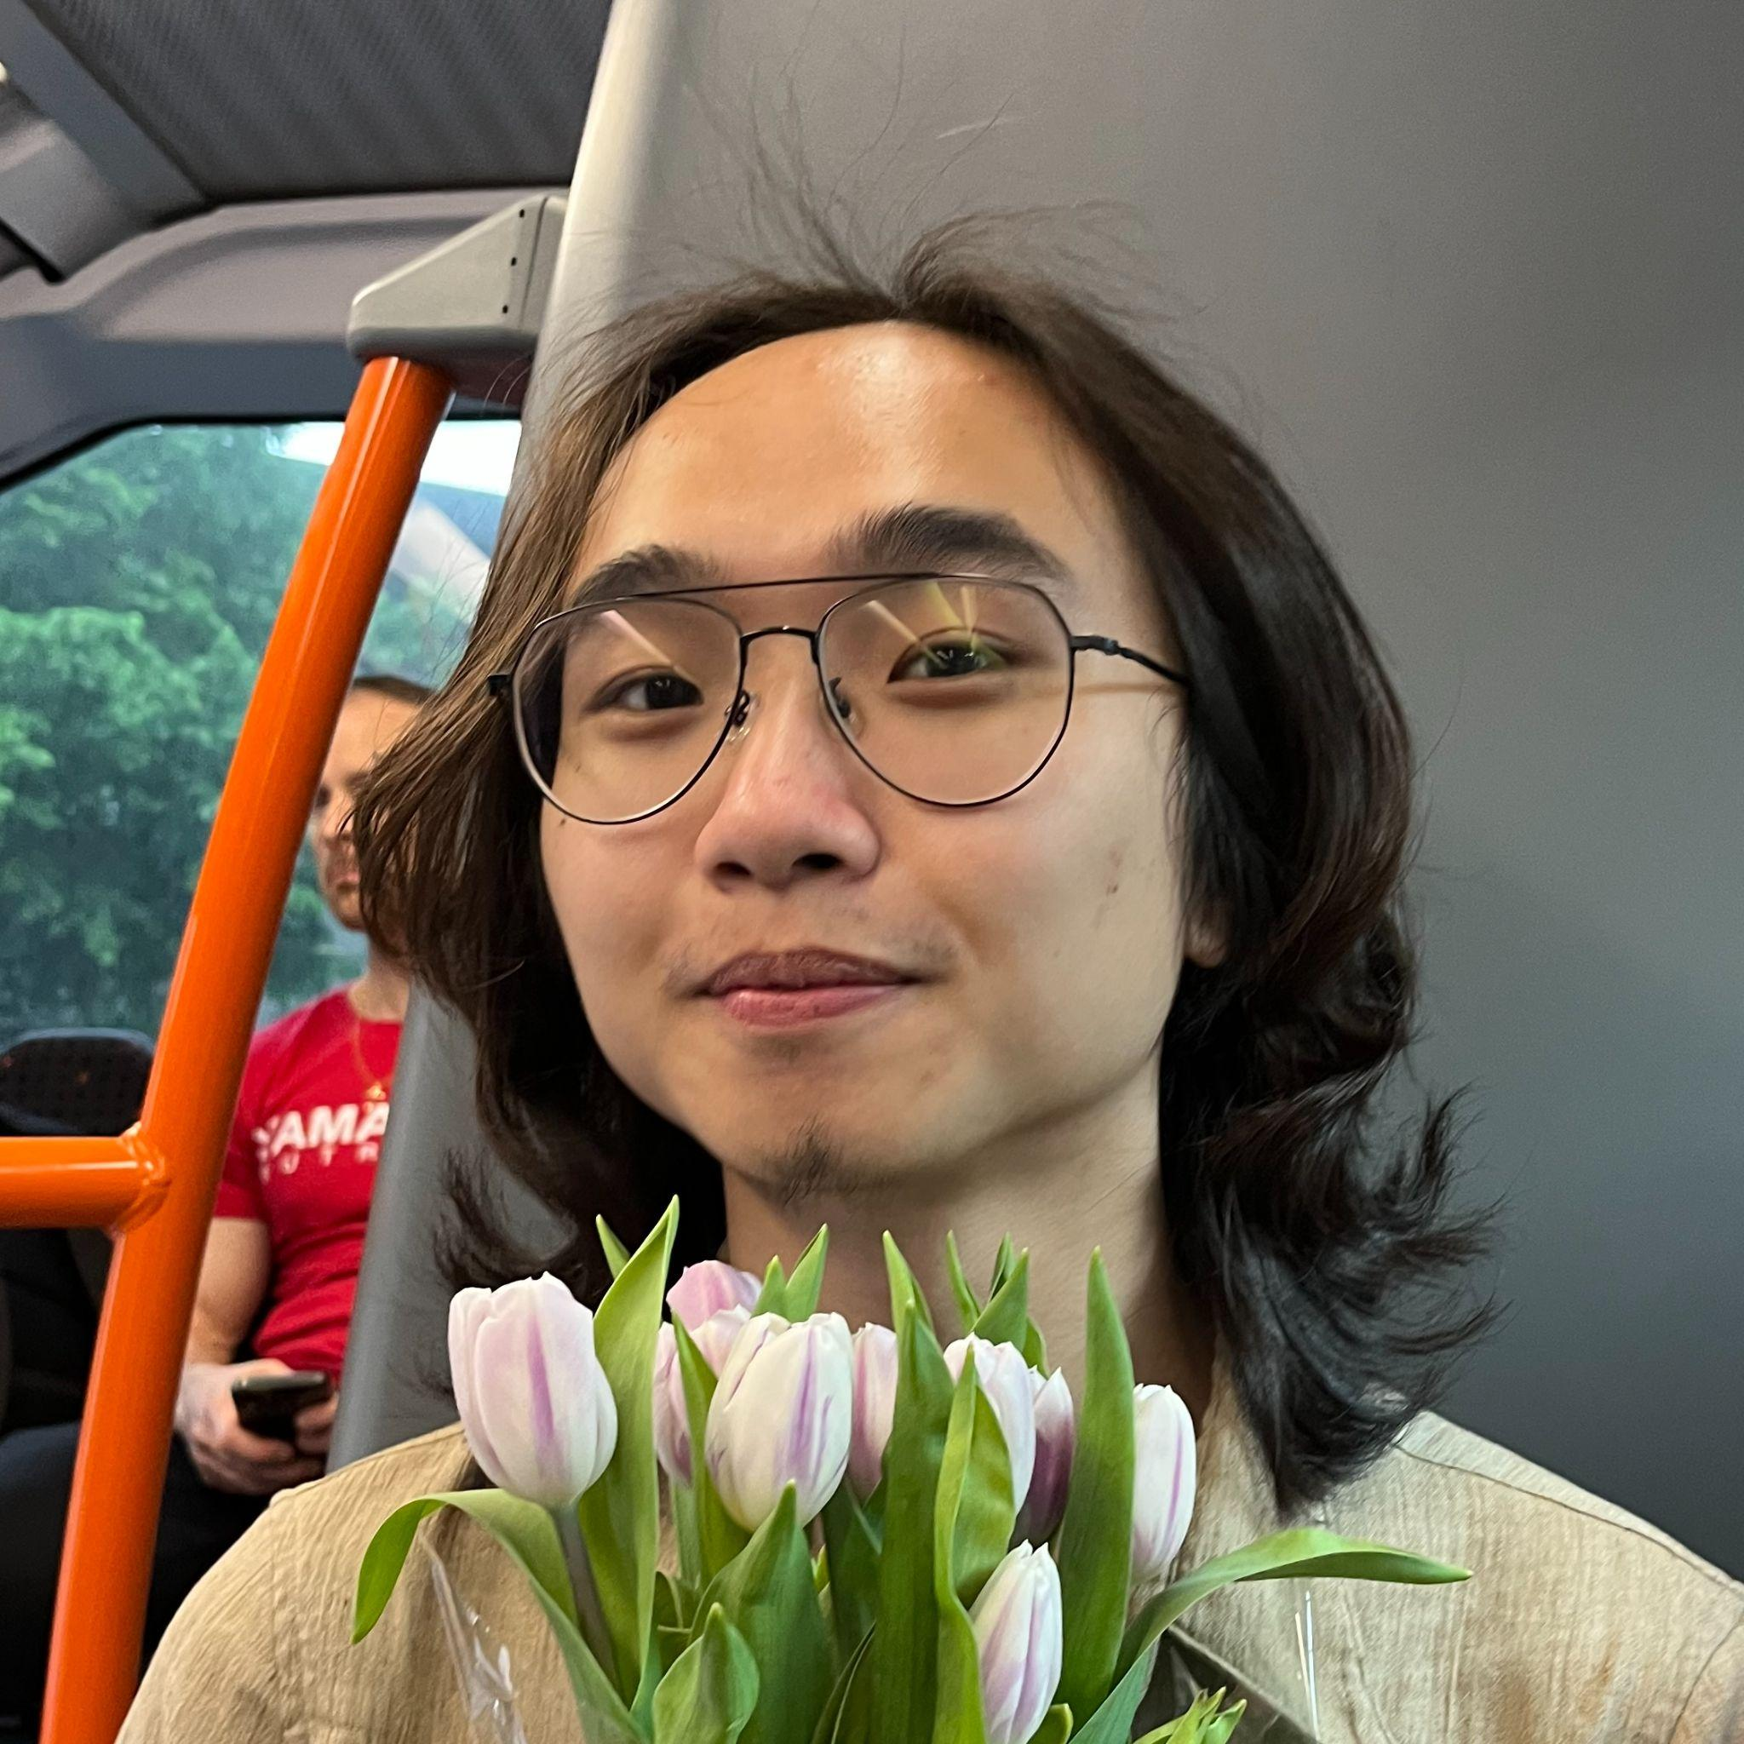
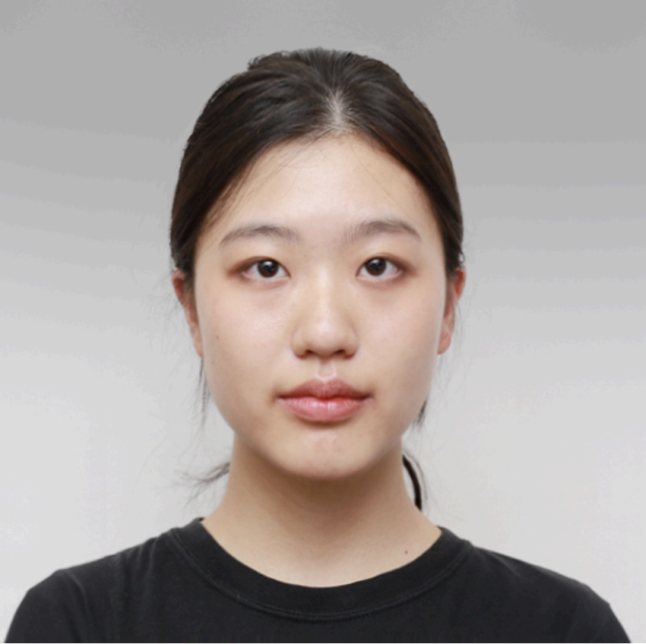
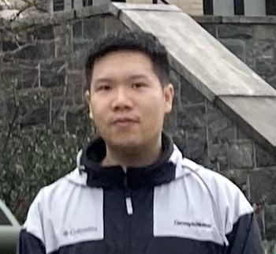
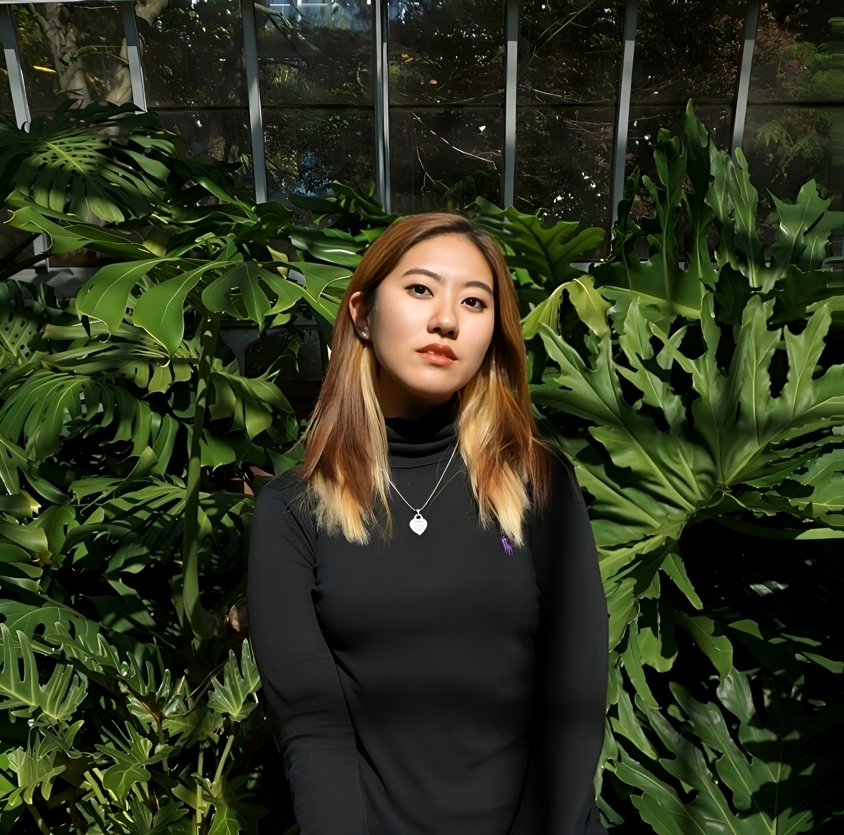
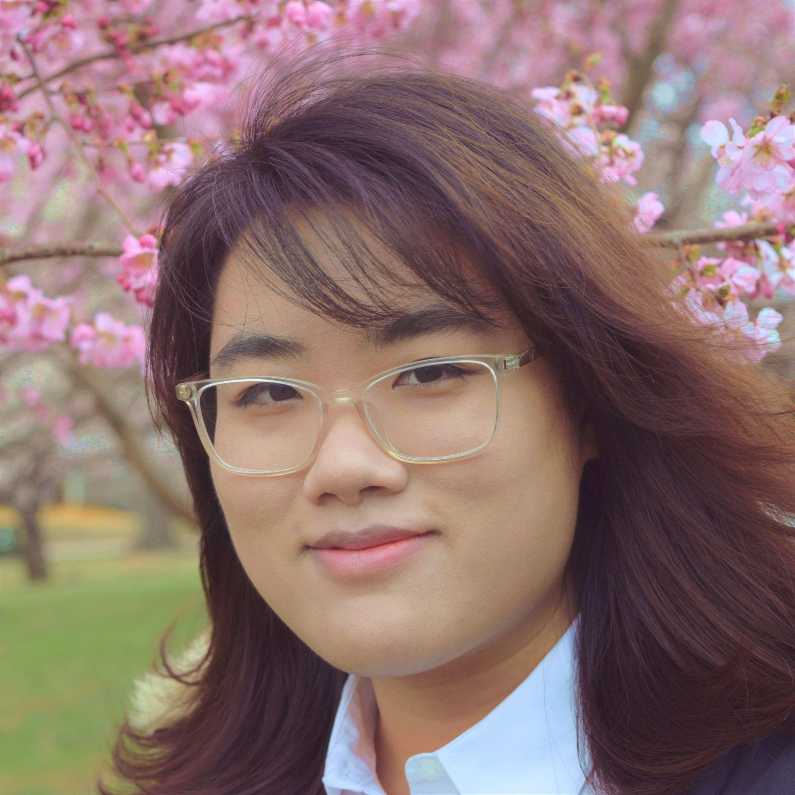
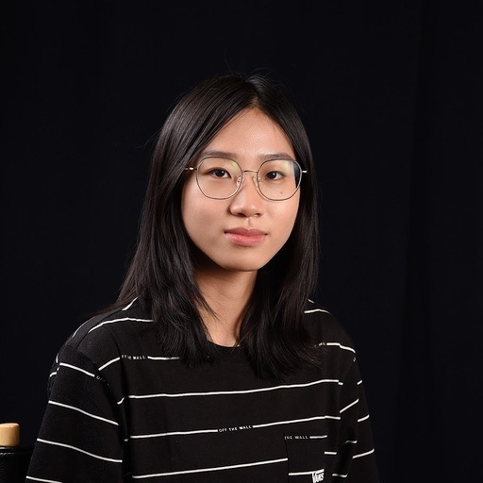
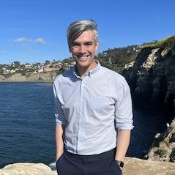
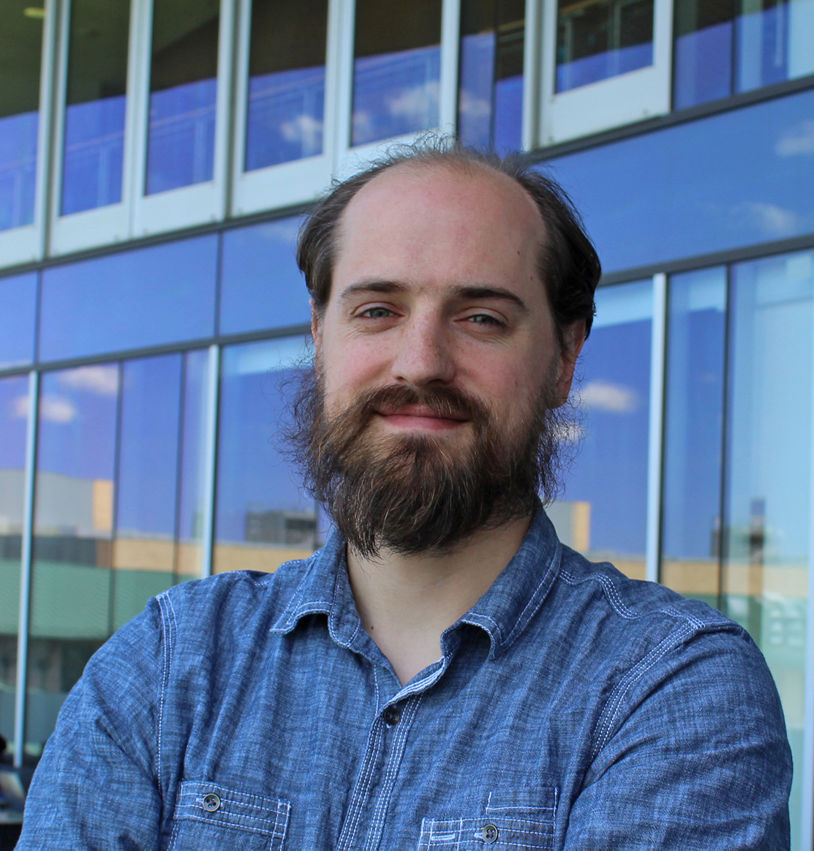
The Team
Glen Smith, Qiao Zhang, Dr. Christopher MacLellan | Georgia Tech
Adit Gupta | Drexel University
Stacey Cho, Jack Dong, Jingyuan Fang, Varun Girdhar, Yutao Huang, Marie Leung, Ziyu Li, Phoebe Wang, Kelly Zheng
Dr. Erik Harpstead | Carnegie Mellon University

Slide 9
Thank you!

